Slide 1
Diagnosing Chest X-Rays with Transfer Learning
Final Capstone Project
2/20/20
By Crystal Yang

Slide 2
Outline
Chest X-ray diagnostics time frame
…in the US
…in rural areas in other countries
A peek at the data
How we can use deep learning to read chest x-rays
Results (so far)
Further research

Slide 3


How Long Does an Medical Image Diagnostic Take?
In the US
Expect imaging results within 1-3 days to receive a call from providers for medical imaging results
Will call providers after 1-5 days
45% of patients reported emotional change (anxiety) while waiting
Outside the US
Example: rural India or China
Medical images are uploaded to a database and volunteers make a diagnosis (telemedicine)
Not fast, questionable sustainability
Woolen S, Kazerooni EA, Wall A, Parent K, Cahalan S, Alameddine M, Davenport MS. Waiting for Radiology Test Results: Patient Expectations and Emotional Disutility. JACR. 2018 Feb;15(2):274-281.; WHO Dept of Essential Health Technologies, Essential Diagnostic Imaging, https://web.archive.org/web/20121023154427/http://www.who.int/eht/en/DiagnosticImaging.pdf ;Images from pexels.com

Slide 4
How Can we Reduce Diagnostics Time?
Can take 20 minutes or more for radiologist to read a medical image
Is there a shortage of radiologists in hospitals?
More radiologists won’t help rural areas either
A solution: Using deep learning to identify conditions/diseases/pathologies in medical images
More specifically, use pre-trained models to apply transfer learning on medical images
Who can use this technology?
Hospitals, clinics, mobile teams such as Doctors Without Borders

Slide 5
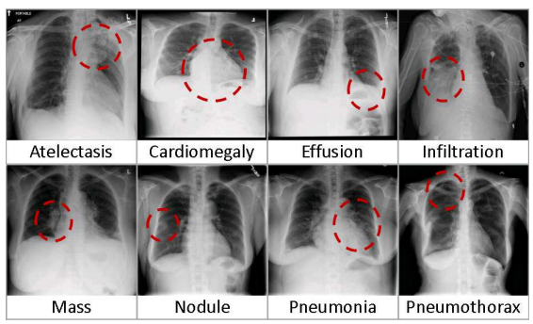
Are There Examples of Medical Images to Test?
NIH dataset has 110k+ chest x-rays from 30k+ patients
14 pathologies and 1 ‘no findings’ class
Total of 15 classes
Images can have multiple classes
Pneumonia – infection in the lung(s)
Effusion – Abnormal accumulation of fluid
 | Pneumonia | Effusion
Percent of Dataset | 1.27% | 11.8%
Number of Images in Training set | ~870 | ~14,000
Wang X, Peng Y, Lu L, Lu Z, Bagheri M, Summers RM, et al. ChestX-ray8: Hospital-scale Chest X-ray Database and Benchmarks on Weakly-Supervised Classification and Localization of Common Thorax Diseases. IEEE CVPR. 2017. 2097-2106

Slide 6
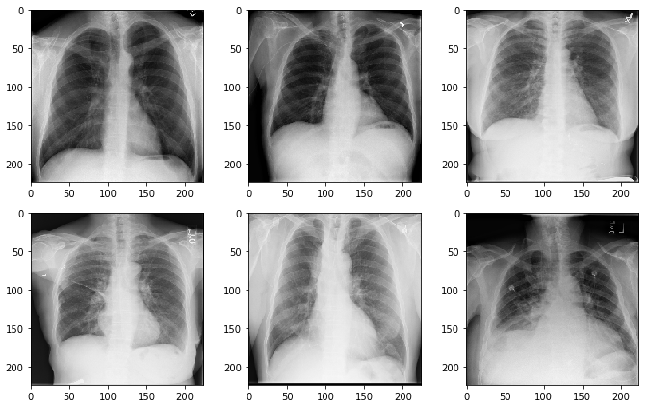
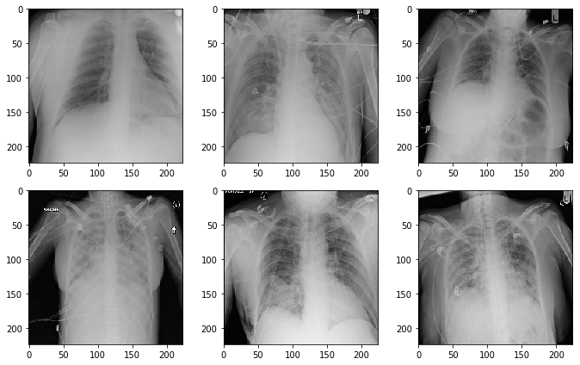
Concerns About the Images?
PA View
AP View
X-rays enters from back and exits the front
X-rays enters from front and exits the back
 | Overall Dataset | Pneumonia | Effusion
PA View | 60.0% | 44.0% | 49.5%
AP View | 40.0% | 66.0% | 50.5%

Slide 7
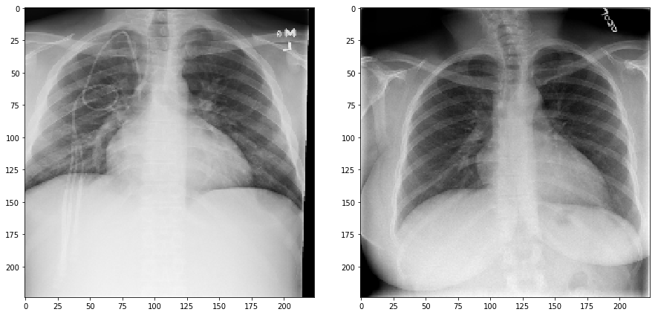
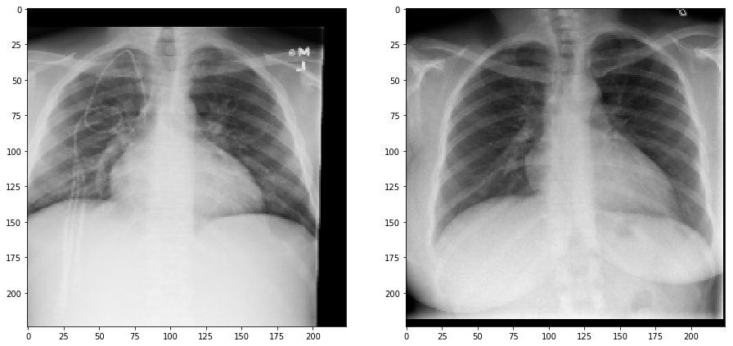
How Does Transfer Learning Work?
Used 3 pre-trained models: VGG19, MobileNet, and ResNet50
Each pre-trained model got 4 scores:
Baseline score
Score after fine tuning layers
Baseline score with augmented images
Score with augmented images after fine tuning layers
Original Images
Augmented Images
Wang X, Peng Y, Lu L, Lu Z, Bagheri M, Summers RM, et al. ChestX-ray8: Hospital-scale Chest X-ray Database and Benchmarks on Weakly-Supervised Classification and Localization of Common Thorax Diseases. IEEE CVPR. 2017. 2097-2106
Notes:
Vgg and resnet generally good results, mobilenet is meant to be computationally light weight and can be used on phones. This would be an interesting model if we can use cell phones to take a picture of xray images and make a diagnosis.
Total 24 scores

Slide 8
Preliminary Results
Pneumonia
Model | Accuracy | Precision | Recall | F1-Score
VGG19 with fine tuning | 53.75 +/- 0.43% | 0.525 +/- 0.006 | 0.800 +/- 0.105 | 0.631 +/- 0.031
MobileNet with fine tuning | 53.78 +/- 0.32% | 0.522 +/- 0.003 | 0.876 +/- 0.069 | 0.653 +/- 0.018
ResNet50 aug with fine tuning | 55.14 +/- 1.34% | 0.530 +/- 0.008 | 0.899 +/- 0.042 | 0.667 +/- 0.013
Effusion
Model | Accuracy | Precision | Recall | F1-Score
VGG19 with fine tuning | 63.06 +/- 1.92% | 0.531 +/- 0.000 | 0.764 +/- 0.109 | 0.672 +/- 0.019
MobileNet | NA | NA | NA | NA
ResNet with fine tuning | 62.76 +/- 0.11% | 0.585 +/- 0.002 | 0.878 +/- 0.009 | 0.702 +/- 0.002

Slide 9
Future Research
Currently only have 2 pathologies, need to expand to all 14.
Explore training of layers more. Its possible that the optimal number of trained layers was not found.
Create a neural network from scratch
Pre-trained models were originally meant to identify common images. This may not have translated as well as I hoped for chest X-ray images

